Slide 1
Database Consistency
How we plan to keep our database consistent

Slide 2
Account Permissions
There will be different levels of accounts
Only Administrator will be able to write to the database
Users will only be able to search and view

Slide 3
When on the Road
When the client is on the road and requires an offline copy, it will be read only
Eliminates need for re-syncing after trips

Slide 4
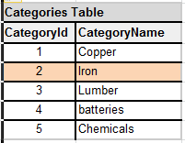
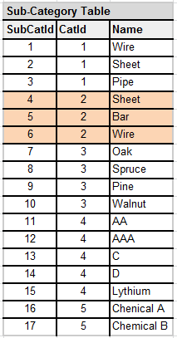
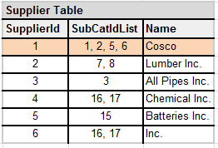
Database Design

Slide 5
Database Design Cont.
We will be using Ids to link our tables so that if an item is changed or deleted in the database, it will be cascaded out to all affected records.
If a Supplier has only one Sub-Category remaining and the user wants to delete that Sub-Category, the system will notify the user that if they delete that Sub-Category, the Supplier and all related information will be deleted.

